Slide 1
CHEMICAL SAFETY and
Incident Reporting
Diana Freas-Lutz
Notes:
Good afternoon! My name is Diana Freas-Lutz. I am the EHS Manager for the Laboratory Safety within Environmental Health & Safety.

Slide 2
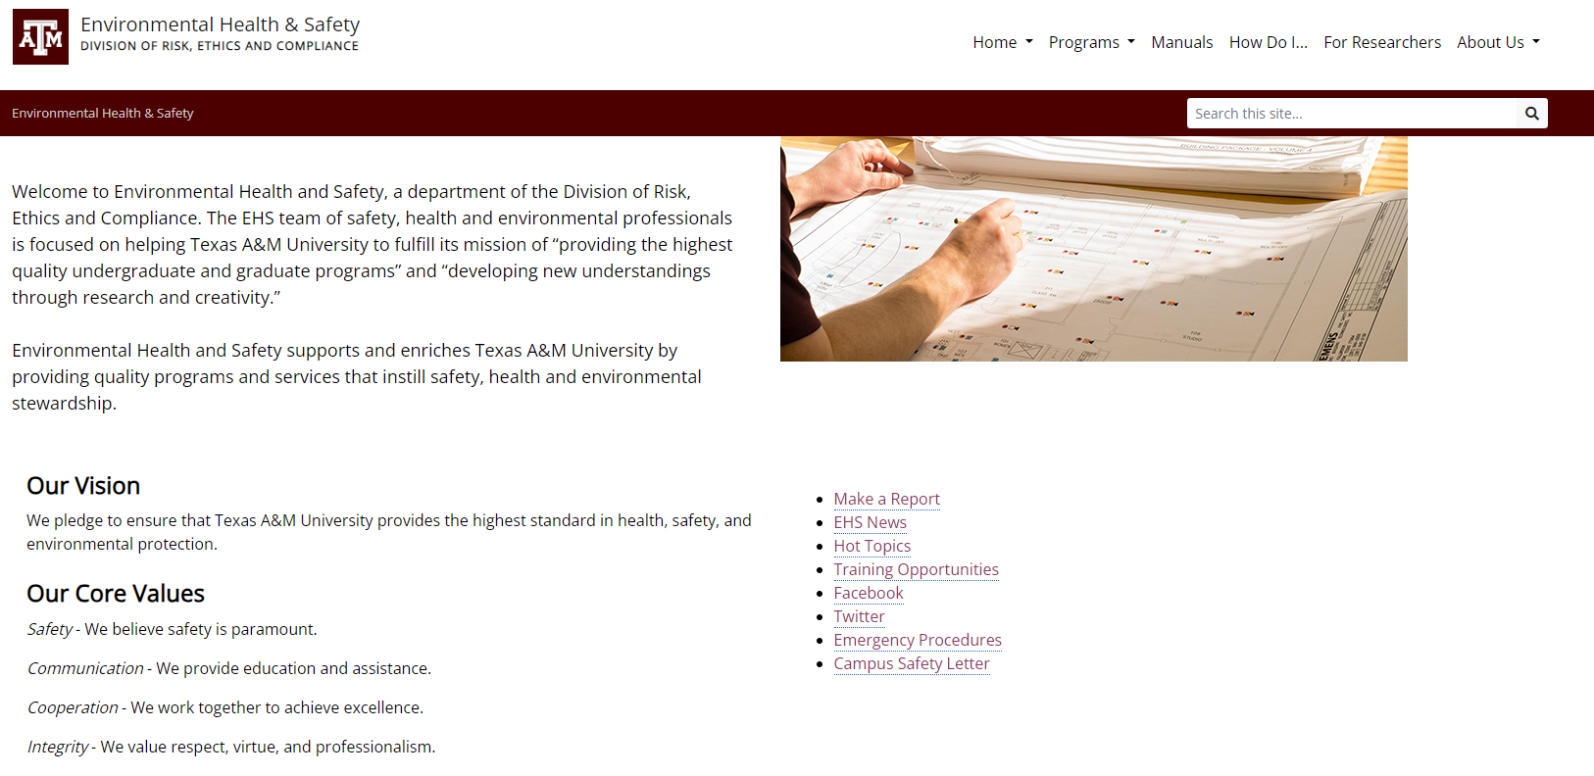
ehs.tamu.edu
labsafety@tamu.edu
Notes:
Environmental Health and Safety (EHS) supports and enriches the university’s programs and services that instill safety, health and environmental stewardship. Our website is ehs.tamu.edu. You may contact lab safety by email at labsafety@tamu.edu. I encourage you to explore the drop down menus on EHS’ webpage for resources to support safety in the laboratory.

Slide 3
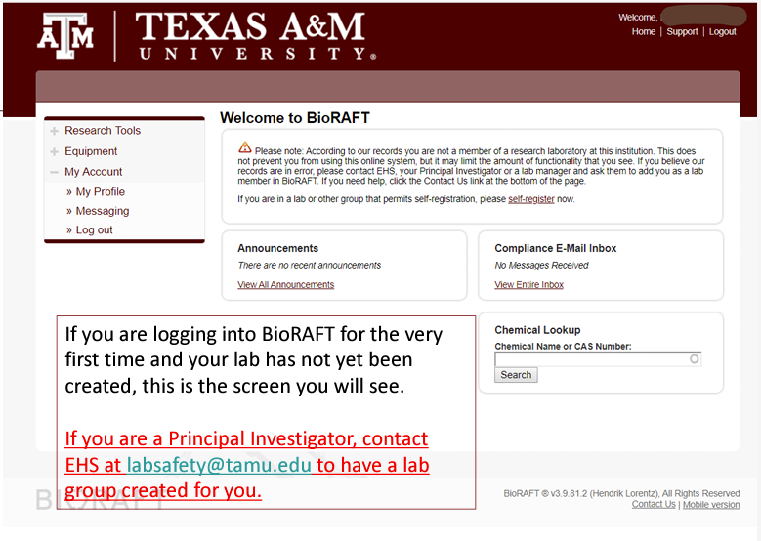
Lab Registration
https://tamu.bioraft.com/
Notes:
Whether you are a new researcher to the University or are moving your existing laboratory to a new space on campus, your lab must be registered with Environmental Health and Safety (EHS). You must request your lab group be created through EHS prior to being able to register your lab.
To register your lab, go to https://tamu.bioraft.com/ and click on the link to enter your Texas A&M University System ID and password.
First time users: PIs logging in to BioRAFT for the first time will be prompted to complete the General Lab Set-up Wizard.
Returning users: PIs who have already completed the initial set-up may go to their lab profile within BioRAFT to verify their spaces.

Slide 4

Lab Registration
“For Researchers” tab – link for guidance document on how to set up lab and verify lab spaces
Lab registration used
    to identify location, contact information, members, hazards of lab spaces
    to determine safety training for all members
    to facilitate in emergency response preparations
Notes:
Under the “For Researchers” tab on the EHS homepage you will see a link for directions on how to set-up your lab and verify lab spaces. Once you select the link, it will take you to a guidance document for self-registration.
Laboratory registration information is used to identify the location of all laboratories and laboratory support facilities, the appropriate contact for each laboratory space, and the hazards in each laboratory. It is also used to determine the appropriate and necessary safety training for all personnel in the laboratory and to facilitate in emergency response preparations.

Slide 5
Training
2114106 : Laboratory Safety Training (Online) - EHS
This online course covers hazards associated with laboratory work; defines laboratory safety precautions, equipment, and recommended practices; and reviews expectations of laboratory personnel.
This course is intended for anyone working in a laboratory.
11020 : Hazard Communication
This course provides an overview of chemical risks and your employee right-to-know, labeling systems, reference materials, physical/health hazards, and the hierarchy of controls to eliminate/minimize exposure to hazardous chemicals.
Notes:
All laboratory workers (PIs, lab managers, lab supervisors, lab/student workers) must complete the General Laboratory Safety Training offered by Environmental Health and Safety (EHS) before they begin work in a laboratory. After the initial training, it is required every 3 years.
Under the Texas Hazard Communication Act, hazard communication training must be completed prior to assigning any duties that may result in exposure to hazardous chemicals.

Slide 6
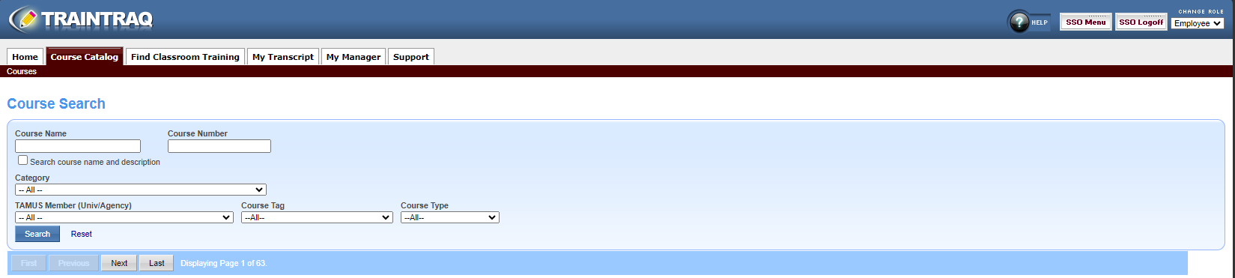
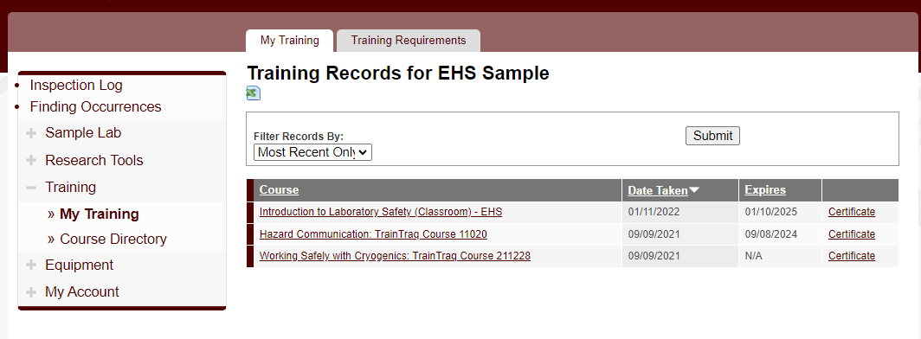
Training
Notes:
TRAINTRAQ is where laboratory safety trainings are completed. TRAINTRAQ can be accessed through your SSO login.
Training can also be accessed by selecting “My Training” on your lab profile page and then selecting the training link where you will be redirected to TrainTraq.

Slide 7
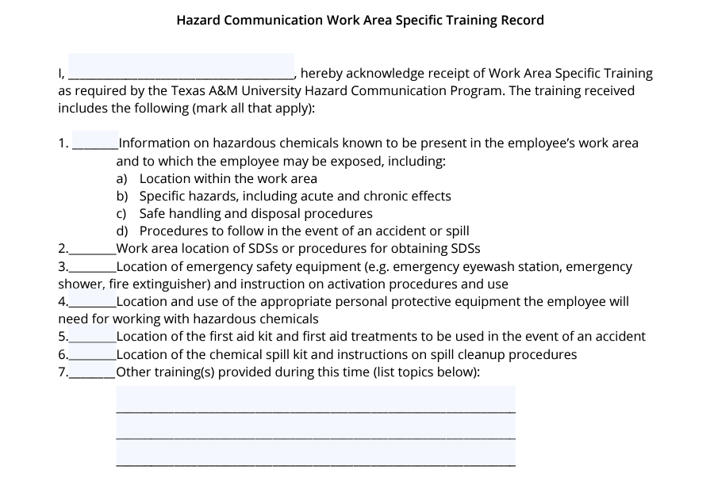
Training
https://ehs.tamu.edu/_media/Files/Hazard-Communication-Training-Record_2023.pdf
Notes:
Additionally, Work Area Specific Hazard Communication Training is required. The form to document this training can be found under the section on forms (Hazard Communication Training Record) within the Laboratory Safety webpage.
Supervisors are responsible for the site-specific employee training that includes:
Once the training is completed, the employee and the instructor sign the document and upload it into the Lab Group profile under the Training tab.

Slide 8
OVERVIEW
Chemical Purchase
Chemical Storage
Chemical Inventory
Chemical Disposal
Notes:
Before I begin to talk about “chemicals in the laboratory” are there any questions?
Chemical safety is an important component of laboratory safety. The topics that I am going to cover today are:

Slide 9
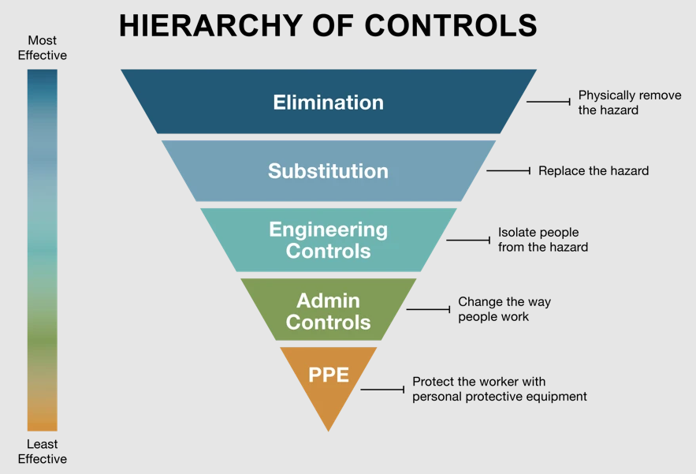
Hierarchy of Controls
Notes:
Before purchasing a chemical, a risk assessment using the hierarchy of controls must be used.
A “Hierarchy of Controls” is used to minimize employee exposure to chemical hazards. The control methods at the top are perceived as more protective than those at the bottom.
Eliminating or substitution of the hazard are the most effective control methods; however, it may not always be feasible.

Slide 10
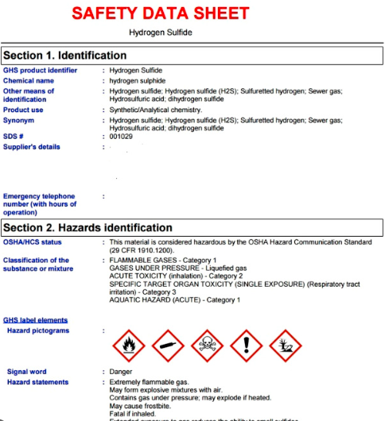

Safety Data Sheet (SDS)
Notes:
Safety Data Sheets or SDSs are the “user manual” for a chemical. All manufacturers are required to generate a SDS for each chemical that you purchase. SDS must be available for those working in all laboratories. Always refer to the SDS that is specific to the manufacturer and product that you purchase.

Slide 11
Safety Data Sheet (SDS)
Section 1: Identification of substance or mixture and the supplier
Section 2: Hazard identification
Section 3: Composition/information on ingredients
Section 4: First aid measures
Section 5: Fire-fighting measures
Section 6: Accidental release measures
Section 7: Handling and storage
Section 8: Exposure control/personal protection
Section 9: Physical and chemical properties
Section 10: Stability and reactivity
Section 11: Toxicological information
Section 12: Ecological information
Section 13: Disposal information
Section 14: Transport information
Section 15: Regulatory information
Section 16: Other information, including preparation of last revision of SDS
Notes:
The information contained in the SDS is required to be in a consistent, user-friendly, 16-section format.
Section 2 - hazards associated with the chemical
If the material you are working with requires the use of a respirator, this information will be found in Section 8.
Safety data sheets (SDSs) can be accessed in Bioraft by utilizing the SDS Search feature.

Slide 12
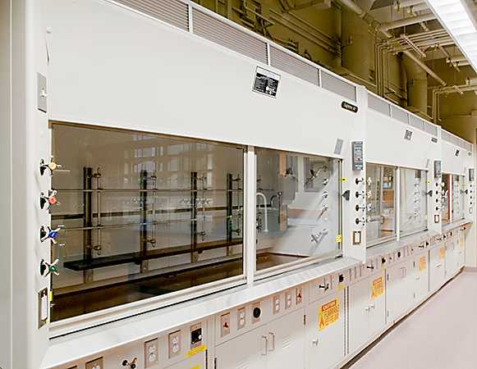
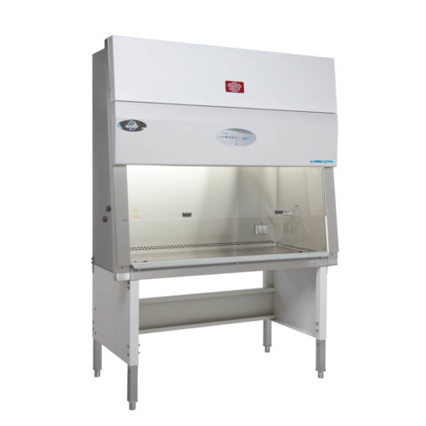
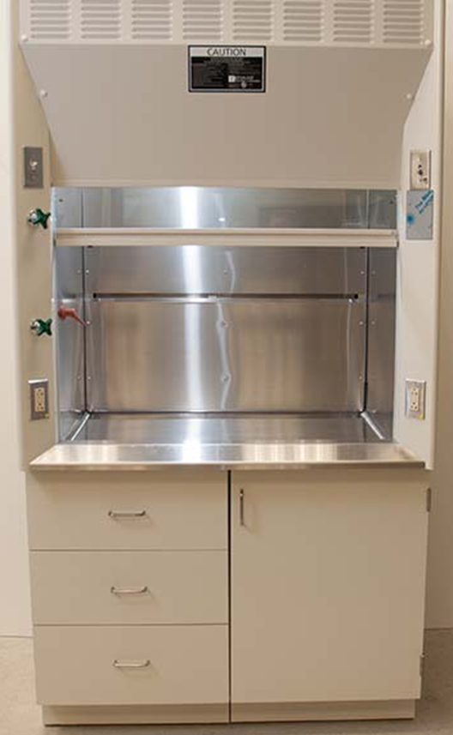
Engineering Controls
Notes:
When eliminating a chemical hazard or substituting it with a non-hazardous alternative is not possible, the next most effective method is to prevent exposure by using an engineering control.
Section 8 of the SDS discusses the appropriate engineering controls to use when working with the chemical.
Examples of an engineering control are shown in this slide. A chemical fume hood shown on the left is a ventilated enclosure used to prevent exposure to vapors and gases. An exhaust fan is typically stationed on the roof of the building and pulls air through the duct work connected to the hood and exhausts it into the atmosphere. A chemical fume hood protects the user.
A perchloric acid hood shown in the middle is specific for the use of perchloric acid has the general characteristics of a bench-top hood, but the interior lining is coved and welded seamless stainless steel. In perchloric acid hood non-reactive and corrosion-resistant material is extended all the way through the exhaust system. The hood, duct, and fan has a water wash down system to remove perchlorates and prevent the build-up of potentially explosive perchlorate salts.
A biosafety cabinet shown on the right protects the user, the environment, and the material. Biosafety cabinets have high-efficiency particulate air (HEPA) filters while chemical fume hoods do not.

Slide 13

Administrative Controls
  Standard Operation Procedure (SOP) –
  written document that contains step-by-step instructions on how to perform certain processes
Notes:
Administrative controls provide protection by changing the way people work. A standard operating procedure (SOP) that advises ordering the minimum amount of certain chemicals needed reduces risk and is an example of an effective administrative control. An SOP is a written document that contains step-by-step instructions on how to perform certain processes.

Slide 14
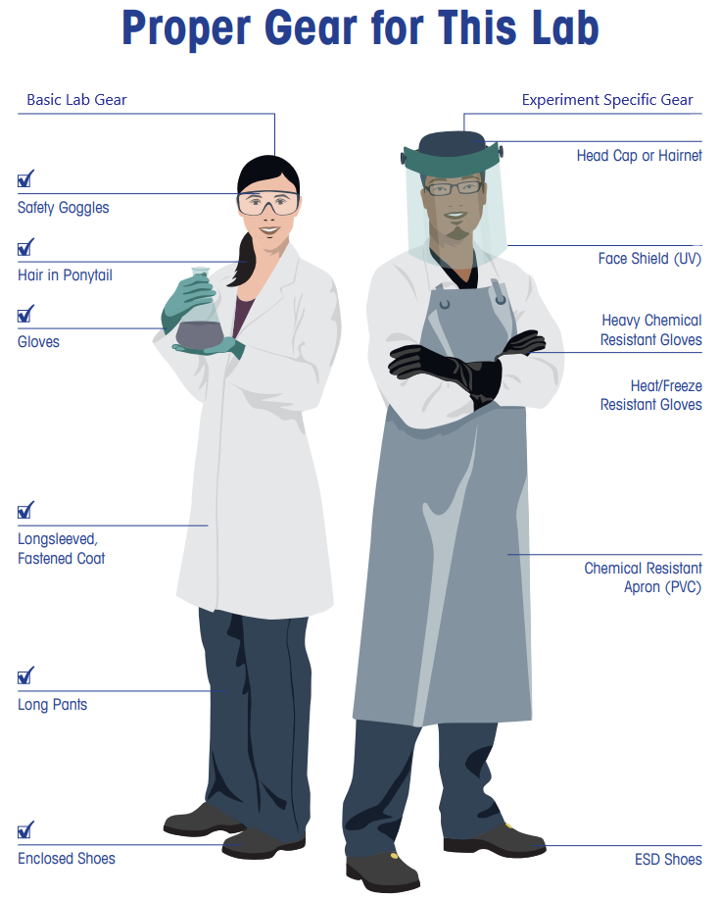
PPE
Notes:
The final method used to protect against chemical hazards is wearing personal protective equipment (PPE) such as gloves, eye protection and respirators. Information on any special requirements for PPE will be found in Section 8 of the SDS.
Note, PPE may be combined with engineering controls.
If an airborne contaminant is so hazardous that a chemical fume hood alone is insufficient to provide adequate protection, a respirator or supplied air can also be used.

Slide 15
First Aid
First aid is any emergency care or treatment given to an ill or injured person before regular medical aid can be administered. Although some aspects of first aid require training, such as CPR, most first aid can be administered by a lay person using common sense and minimal equipment for minor injuries.
Three main aims of first aid: Preserve life. Prevent further injury. Promote recovery.
Provide appropriate first aid using supplies that are available. First aid kits are based on the hazards present in the lab.
Call 911 if it is an emergency or if you aren’t sure if it is an emergency.
Report any injury to a supervisor/PI and ensure it’s also reported through Origami.
Report a Student or Visitor Injury:
Student or visitor injuries can be reported in the Origami portal when an incident occurs with a non-employee on University property. To report a new incident, select “Injured non-employee” at the bottom of the page when asked what applies to the incident.

Slide 16
First Aid
Students can go anywhere for treatment of any injury related to chemicals, as we do not dictate where they *must go.
Consider the severity of their injury and if it would be more appropriate to seek care at an urgent care or full ER in B/CS.
Bring the SDS for the chemical and provide specific information as to the route of exposure, not just seek treatment for a chemical burn, rash, etc. without providing additional information that would be helpful for the treating physician.

Slide 17
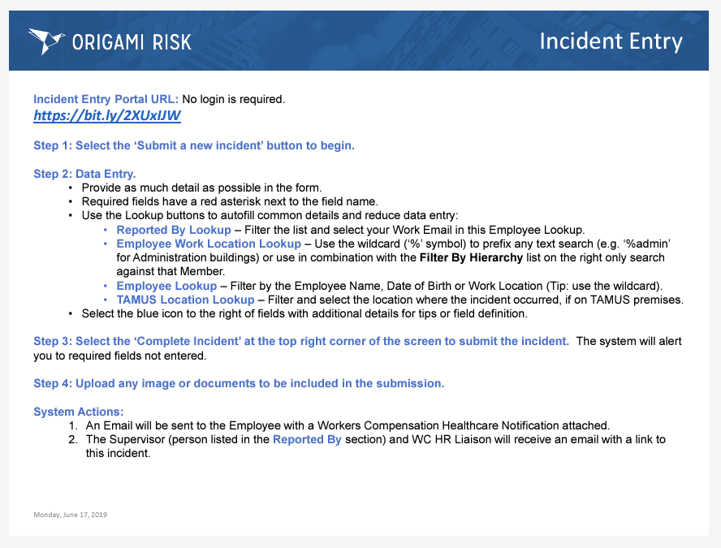
ORIGAMI

Slide 18
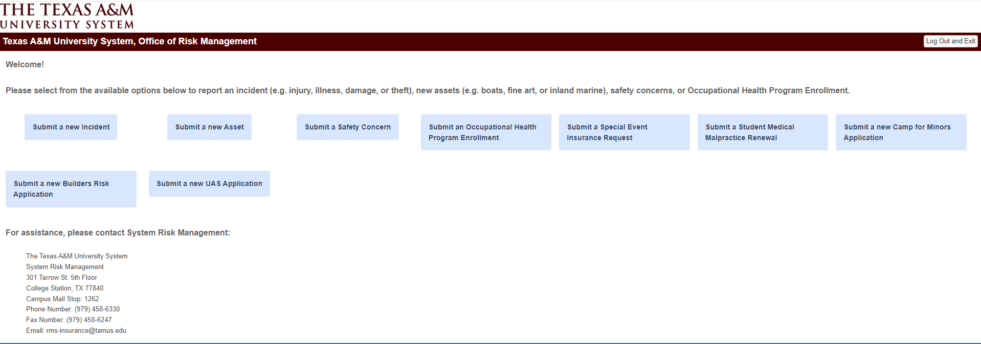
New Incident Report

Slide 19
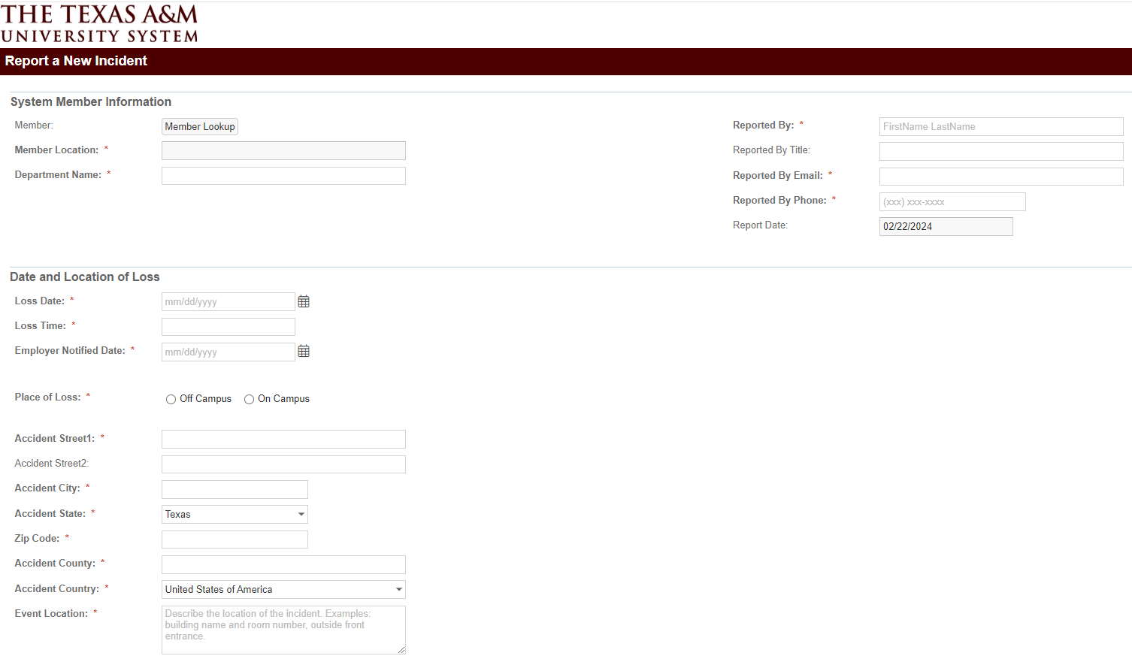
Incident Report

Slide 20
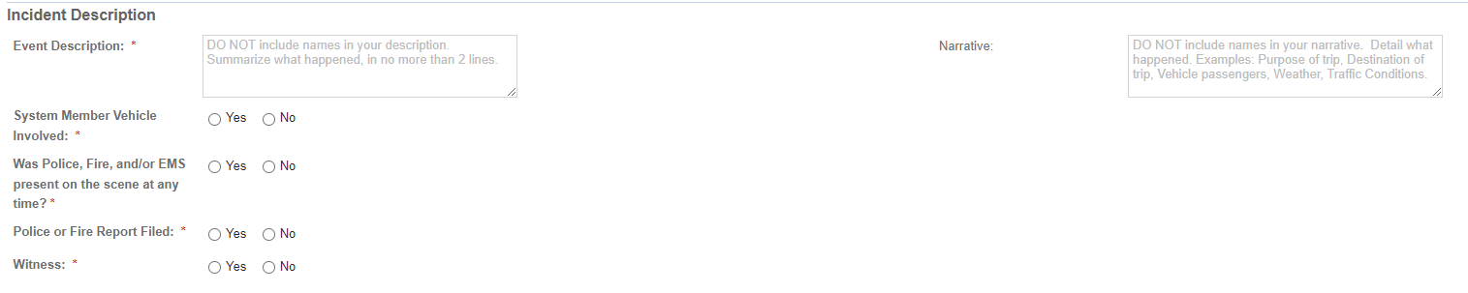
Incident Report

Slide 21
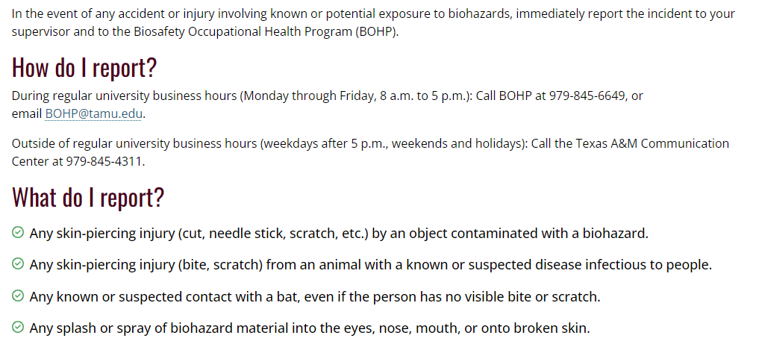
Biological

Slide 22
Environmental Health and Safety
979-845-2132 labsafety@tamu.edu

